Slide 1





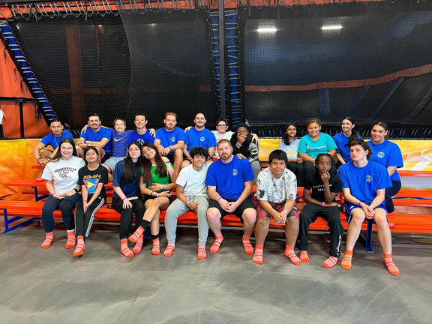

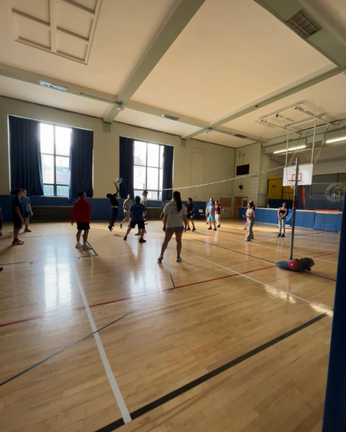


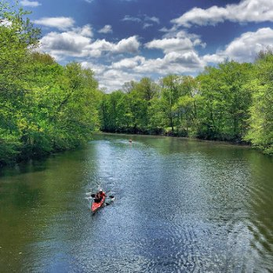
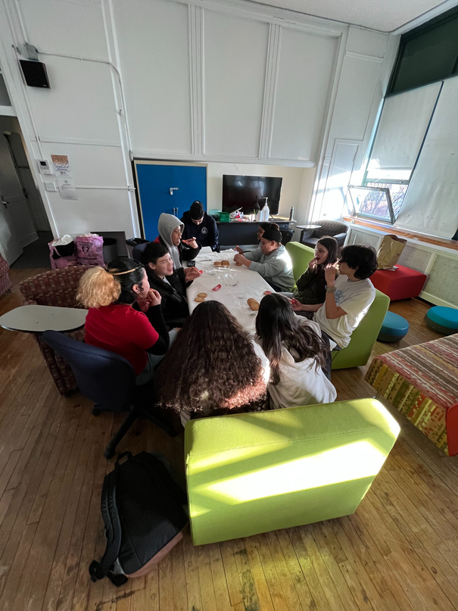




SOMERVILLE
PARKS & RECREATION
Summer
GUIDE FOR TEENS
2024
SOMERVILLE PARKS & RECREATION TEEN PROGRAMMING
www.somervillerec.com

Slide 2




TEENS
12-18
SOMERVILLE
PARKS & RECREATION
Summer
GUIDE FOR TEENS
CLOSED JULY 4 & 5
MONDAYS
2:00-4:00 pm
Pickup Soccer
TUESDAYS
1:00-3:00 PM
VOLLEYBALL SKILLS AND DRILLS
3:00-5:00 PM
BASKETBALL SKILLS AND DRILLS
WITH TAK AND RIC
WEDNESDAYS
2:00-4:00 PM
PICKUP FLAG FOOTBALL
THURSDAYS
2:00-4:00 PM
OPEN GYM AT EAST
FRIDAYS
1:00-3:00 PM
POWDERHOUSE
LOCATION:
CAPUANO FIELD
LOCATION:
EAST SOMERVILLE GYM
LOCATION
EAST SOMERVILLE GYM
LOCATION:
CAPUANO FIELD
LOCATION:
EAST SOMERVILLE GYM
LOCATION:
850 BROADWAY
Teen Summer Programs are to be determined, use our QR code to access the up-to-date summer calendar

Slide 3


CAPUANO FIELD
FREE SUMMER
TEEN PICKUP SOCCER
TEENS AGES 12-18
Drop by and play pickup soccer during the summer! You bring the teens, we’ll provide the equiptment!
MONDAYS
JULY 1-AUGUST 5
2:00 PM-4:00 PM
Must register online: somervillema.myrec.gov

Slide 4

SOMERVILLE PARKS AND RECREATION TEEN PROGRAMMING IS OFFERING A
FREE 6-WEEK
TEEN SUMMER VOLLEYBALL CLINIC
6 week program teaching and enhancing skills, drills, scrimmages, and more!
JULY 2-AUGUST 6 2024 -
THURSDAYS 1:00-3:00 PM
EAST SOMERVILLE COMMUNITY SCHOOL GYM
Must register online, only a limited number of spots!

Slide 5




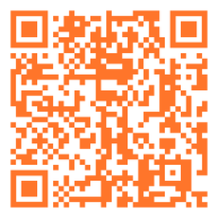
BASKETBALL
SKILLS AND DRILLS
FOR TEENS
TUESDAYS
JULY 2-
AUGUST 6
3:00-5:00 PM
EAST SOMERVILLE COMMUNITY SCHOOL GYM
TEENS 12-18 YEARS OLD
MUST REGISTER ONLINE--LIMITED SPOTS
SIGN UP HERE!

Slide 6


SOMERVILLE PARKS AND RECREATION TEEN PROGRAMMING AND SOMERVILLE HIGH SCHOOL FOOTBALL PROGRAM PRESENTS...
FREE TEEN
PICKUP FLAG FOOTBALL
LEAGUE
CAPUANO FIELD
WEDNESDAYS
JULY 3-AUGUST 7
2:00-4:00 PM
Must Register Online
Teens 12-18

Slide 7

2024
SUMMER
FREE TEEN
OPEN GYM
THURSDAYS
JULY 11-AUGUST 8
2:00-4:00 PM
EAST SOMERVILLE GYM
SOMERVILLEMA.MYREC.COM

Slide 8















SOMERVILLE PARKS AND RECREATION TEEN PROGRAMMING
summer
at powderhouse
FRIDAYS
1:00-3:00 PM
JOIN
HERE!
JULY 12-AUGUST 9
857-300-3272
WE WILL HAVE SNACKS, GAMES, CRAFT PROJECTS, ART SUPPLIES, AND MORE!

